Slide 1
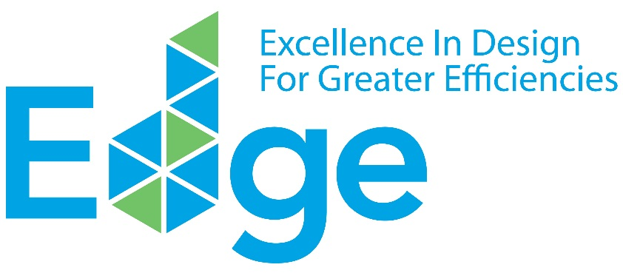
EDGE DISCOVERY WORKSHOP
for Property Developers
www.edgebuildings.com
Notes:
Welcome to the EDGE DISCOVERY WORKSHOP for Property Developers. Thank you for joining us today.
I am…
Our workshop today will cover the following subjects:
Understanding the business case for green buildings
Defining a green building
Summarizing the benefits of green buildings to all
Exploring the progress of green buildings in Mexico
Considering how IFC’s EDGE answers your needs
Demoing the EDGE software together
Reviewing the EDGE certification workflow; and
Analyzing case studies of developers certifying their portfolios with EDGE

Slide 2
IFC IS A MEMBER OF THE WORLD BANK GROUP
________
IBRD
International
Bank for Reconstruction and Development
IDA
International Development Association
IFC
International Finance Corporation
MIGA
Multilateral Investment Guarantee Agency
ICSID
International Centre for Settlement of Investment Disputes
Loans to middle-income and credit-worthy, low-income country governments.
Interest-free loans and grants to governments
of poorest
countries.
Solutions in
private sector development.
Guarantees of foreign direct investment’s non-commercial risks.
Conciliation and arbitration of investment disputes.
Notes:
Before we start, I’ll introduce IFC.
IFC is a member of the World Bank Group.
IFC is focused on solutions for private sector development and part of its mission is to create markets that support climate business.

Slide 3
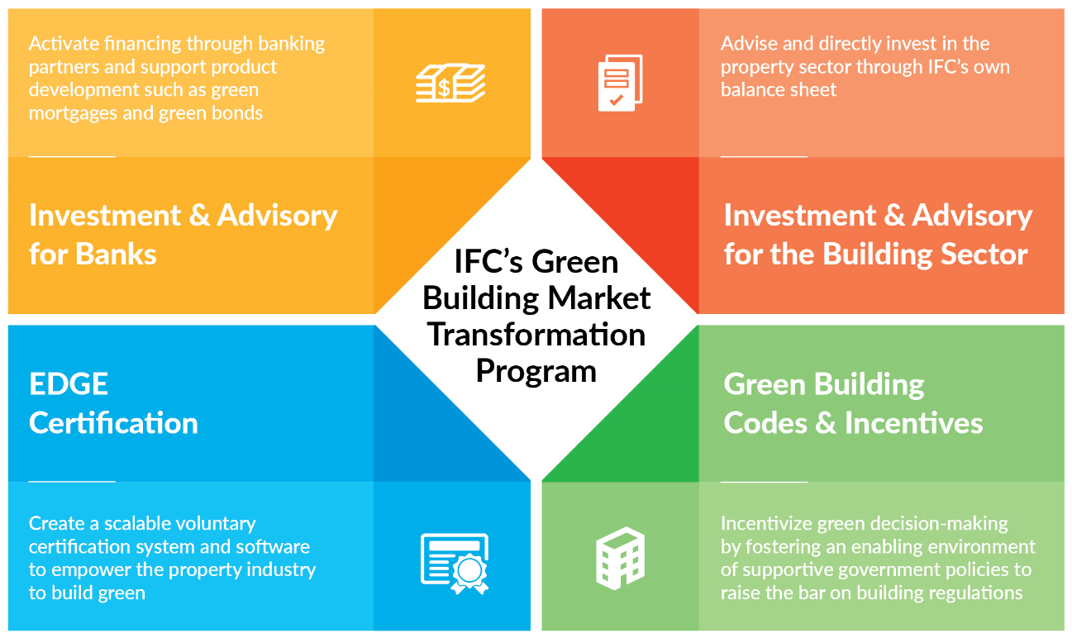
IFC HAS A FOUR-PART STRATEGY TO SUPPORT
GREEN BUILDING GROWTH
________
Further Resource: About EDGE
Notes:
IFC created its Green Building Market Transformation Program to take a leadership role in encouraging a new paradigm where financial institutions, governments, the property sector and consumers all come together to benefit financially through the mainstreaming of green buildings.
The program addresses the gap in the market for an international green building standard that offers a free software solution to help identify the most cost-effective solutions to design and build green, to unlock the potential for a new era of green construction and development.
IFC’s 4-part strategy supports diverting investment to green buildings, through working with banks, investing directly into the building sector, advising governments on green building codes and incentives, and the EDGE certification program.
So far, IFC has mobilized $4.5 billion in green building investments – from its own account and through syndicated loans. Out of that, $876 million – or 20 percent of all investments – is through other financial institutions. IFC believes in the business case for green buildings and how they’re a win-win for all.

Slide 4
Definition of A Green building
________
20%
20%
20%
20%
&
&
20%
MATERIALS
ENERGY
WATER
Better
performance
than THE
local baseline
CertifiABLY GREEN
AS VERIFIED BY
AN INDEPENDENT
THIRD PARTY
Quantified
impact reporting
Notes:
Let’s step back and define what we mean by “a green building.”
A green building needs to be at least 20% more resource efficient than a comparable baseline building in the local market.
A green building must also obtain a local or international standard of green building certification, as verified by an independent party.
Finally, in order to satisfy green finance requirements, projects must have quantified impact reporting – reporting on an individual project basis and on a portfolio basis, such as energy and water saved or reduced GHG emissions.

Slide 5
WHY EDGE: DIFFERENTIATING PROPERTIES THROUGH EDGE CERTIFICATION
________
ADVANTAGES FOR DEVELOPERS
Positioning as a first mover in the market with a major marketing and communications push backed by the World Bank Group brand
Objective
Potentially higher prices or quicker sales through differentiation
To provide property developers with a competitive advantage through product differentiation, capturing all of the benefits of certification affordability, a streamlined certification process, and association with the World Bank Group brand.
Online certification process from A to Z with the most affordable certification fees and free use of the design software.
Lowered costs by incorporating EDGE early into the design process
Certification reduces reputational risk, satisfies compliance criteria, and communicates value to buyers
Notes:
Let’s summarize the advantages of a green building investment program for developers.
You’ll be positioned as a first mover in the market with a marketing and communications push supported by IFC. Through EDGE, you can associate your brand with the World Bank Group.
This differentiation can lead to higher prices or quicker sales, particularly in a crowded market.
You can benefit from the easy-to-use EDGE online certification process, which guides you every step of the way, from A to Z. The process is backed by the sophisticated EDGE software which can be used for free.
By incorporating EDGE early into your project design, you can keep costs low. Many developers tell us that reaching the EDGE standard had zero incremental costs.
Certification reduces reputational risk, satisfies compliance criteria with investors, and verifiably communicates value to buyers.

Slide 6
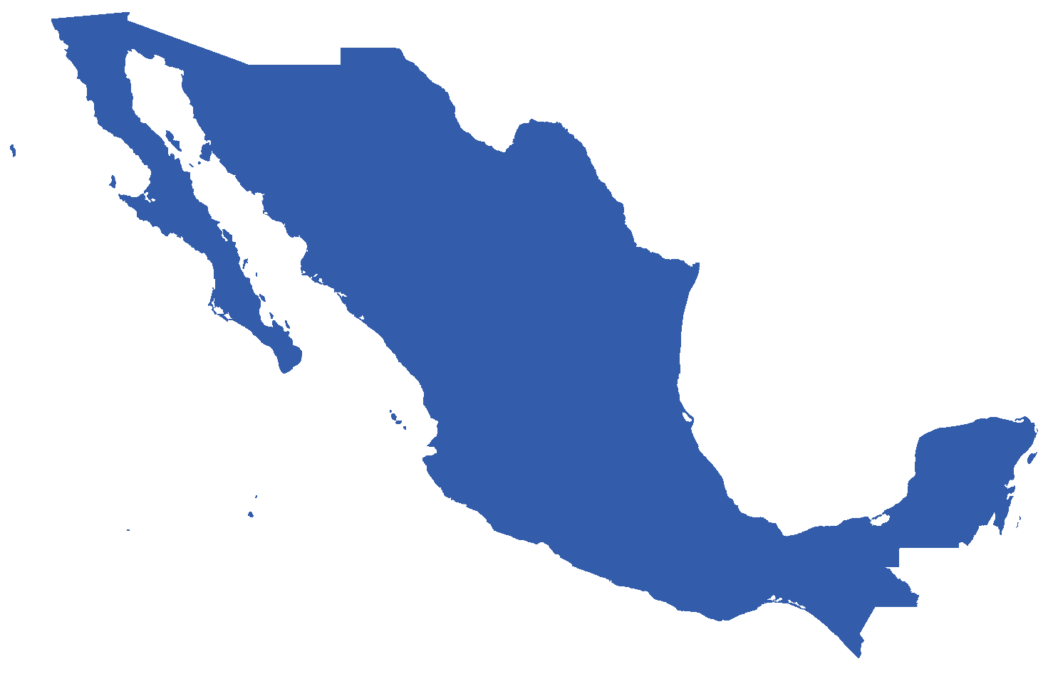
THE LEADERSHIP OPPORTUNITY FOR CERTIFIED
GREEN BUILDINGS IN MEXICO
________
1,100 LEED projects either registered or certified
Seventh worldwide in project count
16 million square meters certified
GREEN LEADER
SUMe – Mexico’s green building council
Government initiatives
EcoCasa and INFONAVIT
LOCAL PROGRAMS
IFC projects a $30 billion investment opportunity through 2030
Potential for 170,000 green residential units through 2030
LARGE OPPORTUNITY
Source: IFC’s EDGE Green Building Market Intelligence
Notes:
There’s a leadership opportunity for developers who choose to certify their buildings green – both globally and locally.
Here in Mexico, the green building market is experiencing rapid growth. Over 1,100 commercial projects are either registered or certified with LEED certification. Because of you, Mexico is a global green leader, ranking as the seventh country in the world for LEED-certified projects, totaling 16 million square meters of floor space.
This is due to the belief in green buildings by developers such as yourselves and strong local programs.
As you are well aware, progressive government policies have led to the most innovative green mortgage program in the world through INFONAVIT, which has benefited millions of low-income residents. Tens of thousands of energy-efficient homes have been brought onto the market annually through Sociedad Hipotecaria Federal’s EcoCasa program.
There is also an active green building council in SUMe.
This momentum leads to an opportunity to gain a competitive advantage and differentiate properties as green, particularly in the residential sector. IFC projects a $30 billion investment opportunity in green buildings through 2030 with a potential for 170,000 green residential units.

Slide 7
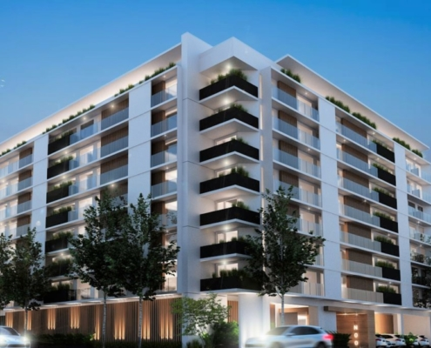
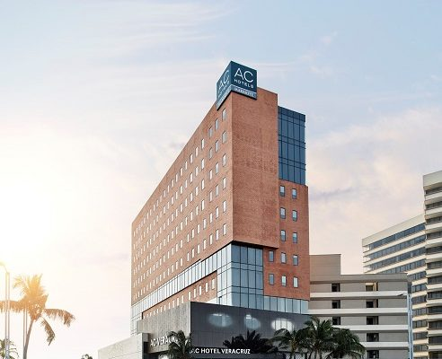
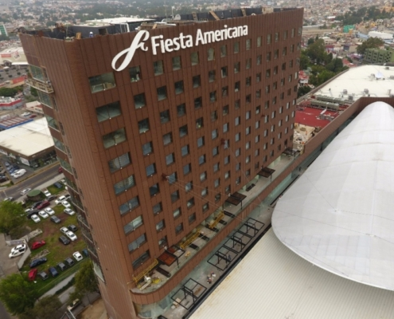
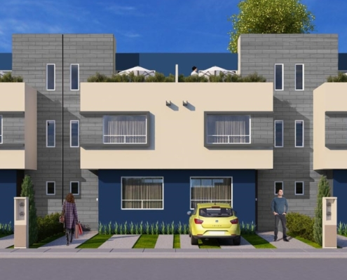
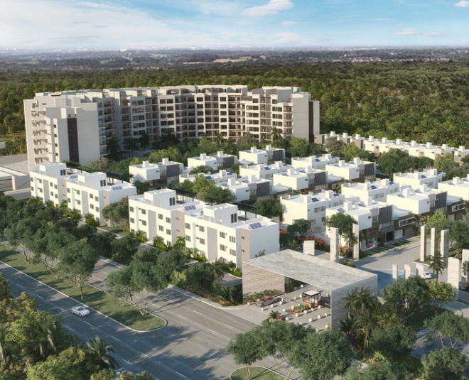
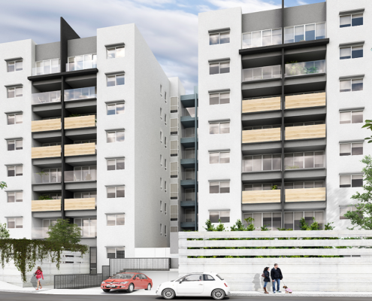
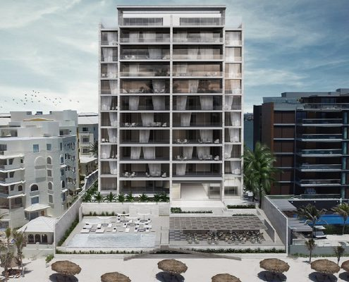
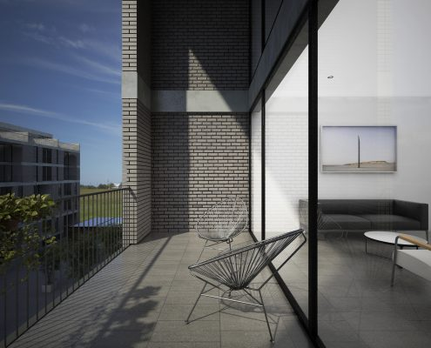
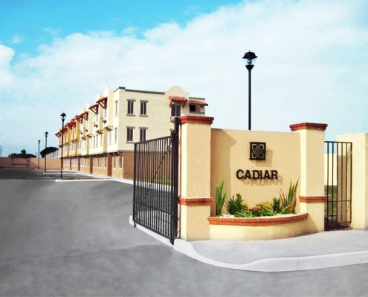
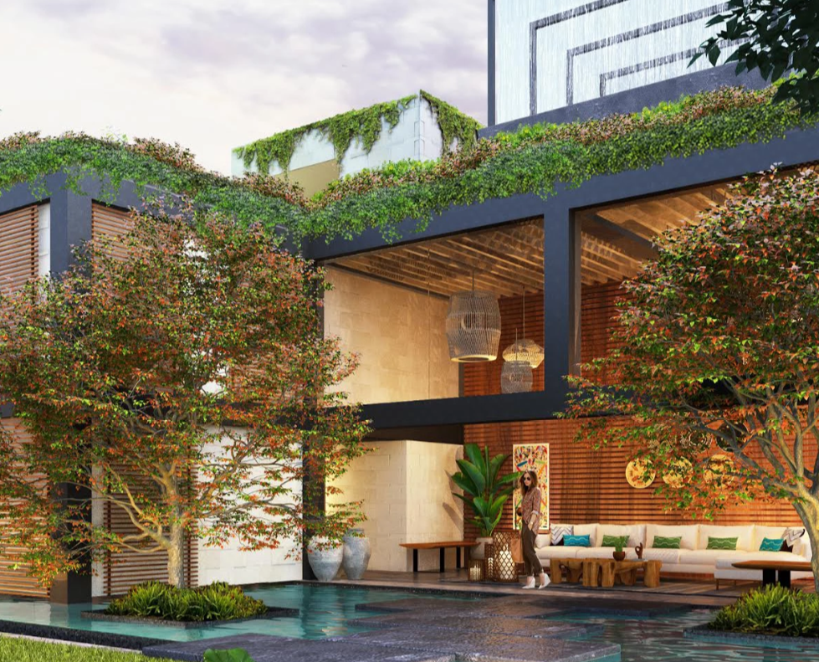
MOMENTUM IS BUILDING FOR EDGE IN MEXICO
Revolucion 757
By FICADE
AC Hotel by Marriott
By Grupo Posadas and Fibra
Fiesta Americana
By Grupo Posadas and Fibra
Villas del Fresno
By Paladin Realty/Casas Krea
Zivalam
By Grupo IKON
Acalli
By Promotora Vivela
KAANA
By Metric Development Group
Cumbres Residencial
By Lares Desarrollos
Real Granada
By VINTE
Bloom Tulum
By BCG
Notes:
Momentum is building for EDGE in Mexico.
More than 546,000 square meters of floor space have been either registered or certified by such early adopters as Vinte, FINSA, and Grupo Posadas.
There are over 1,500 projects uploaded into EDGE, which we consider “early pipeline.”
Of these, 22 projects are actively looking for green financing.

Slide 8
HOW CAN YOU CHOOSE THE MOST COST-EFFECTIVE OPTIONS TO DESIGN GREEN? AND How will YOUR customers recognize the value?
Notes:
So, now you may ask – how can you choose the most cost-effective options to design a green building? And how will your customers – whether home owners or commercial tenants – recognize the value of a green building?
Before, it was difficult to know the best way to build green.
There wasn’t an easy way to figure out which green ideas would work the best, and how much they would cost.
There was a need to know the numbers, but no way to find them.
The time was right for a solution that could measure how to turn an ordinary building into a high performing one – before it’s been built.
IFC created EDGE to address challenges that emerging markets face and ensure developers gain a competitive advantage for their commitment to high-performance buildings that make a low impact on the environment.

Slide 9
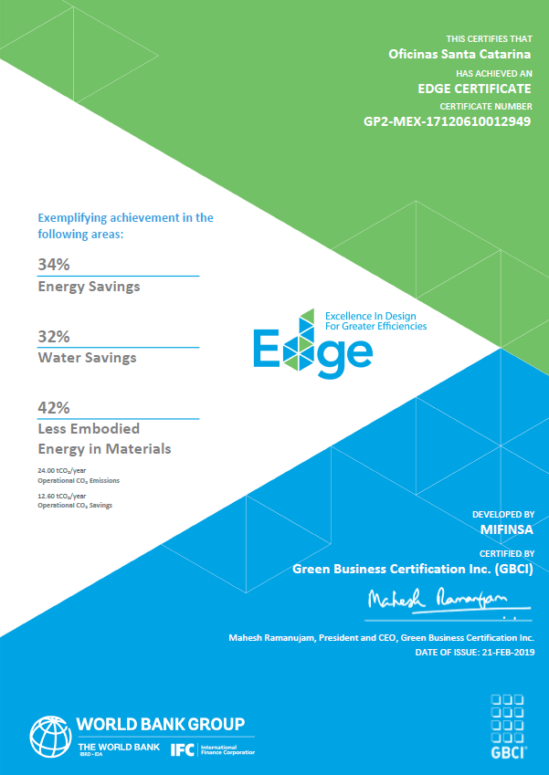
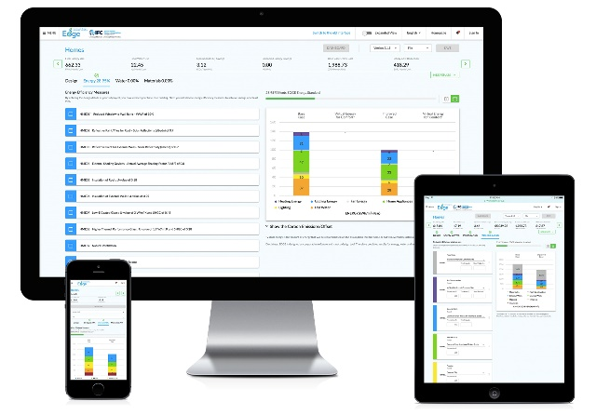
The SOLUTION IS EDGE
________
① FREE SOFTWARE
② ACHIEVABLE STANDARD
③ verified green label
20%
Notes:
The solution is EDGE, which stands for “Excellence in Design for Greater Efficiencies.”
EDGE consists of three components:
First, the free software helps you choose the most cost-effective ways to build green. The software is free and can be accessed from our website.
Second, EDGE is an achievable green building standard with a 20 percent resource-efficiency criteria.
And third, EDGE is a certification system to verify and reward green building projects through a green label.

Slide 10
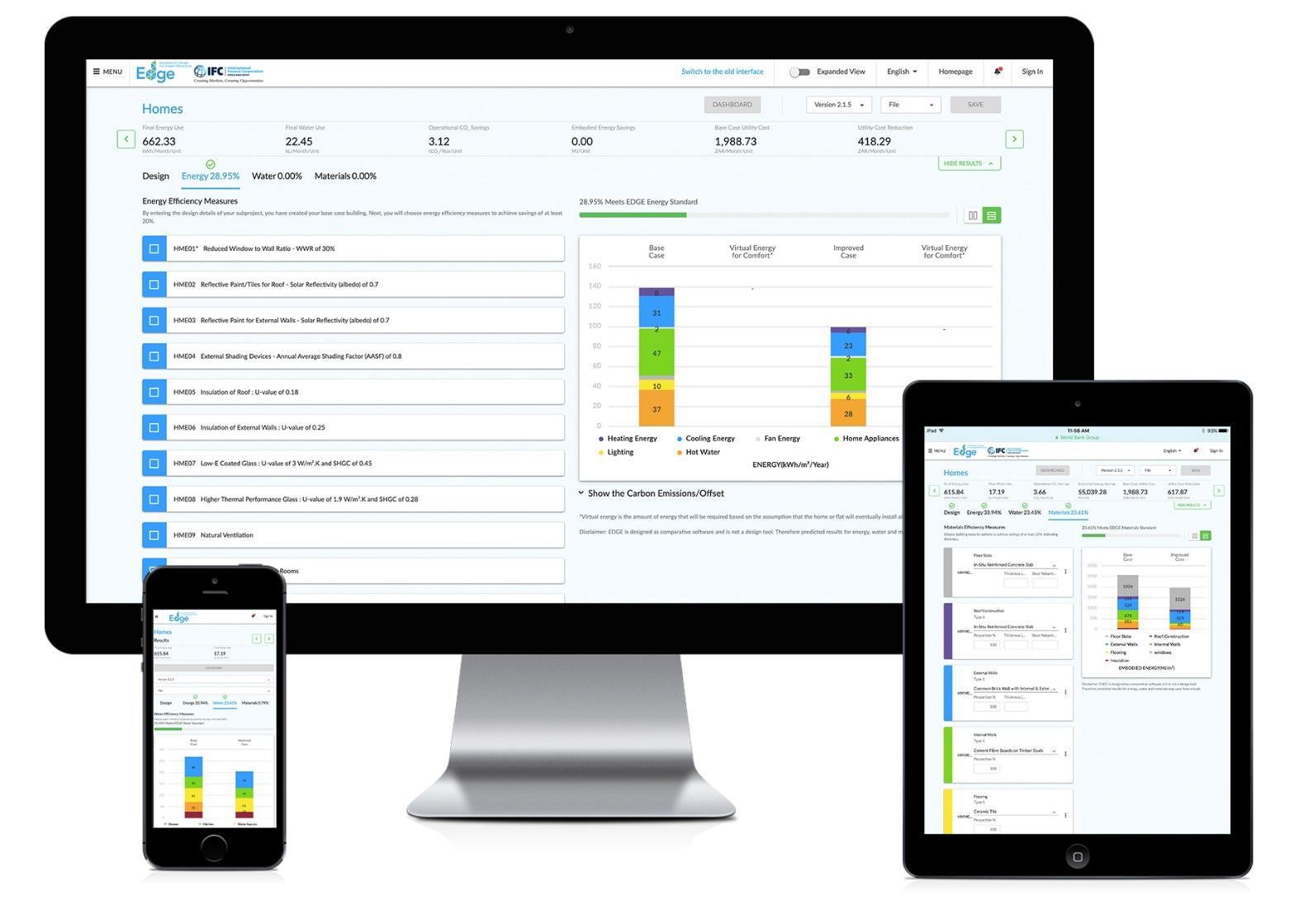
THE FREE SOFTWARE SHOWS HOW TO CUT BACK ON THE RESOURCE INTENSITY of A Building’s design
________
Notes:
The EDGE software is the first of its kind in the world.
The complexity of the application is hidden beneath the user interface, making it easy for you to cut back on the resource intensity of your building designs.

Slide 11
EDGE is available across all sectors, for buildings of all vintages
________
Existing Buildings & refurbishments
New Buildings
Portfolio certifications
Homes
Hospitality
Hotel
Serviced Apt
Resort
retail
Department store
Shopping mall
Supermarket
Big box store
Food store
Airport
Offices
Hospitals
Hospital
Clinic
Nursing home
Education
Pre-school
School
University
Sports facility
Religious facility
Industrial
Warehouse
Light industrial
Notes:
EDGE certification is possible for new and existing buildings, suiting a variety of typologies.
Multiple projects can be certified with a portfolio approach, to transform a company’s business model and maximize profits.

Slide 12
THE edge STANDARD Focuses on THREE CATEGORIES OF resource efficiency
________
20%
20%
20%
20%
20%
MATERIALS
ENERGY
WATER
Further resource: EDGE Methodology
Notes:
To reach the EDGE standard, a project must reach 20 percent savings in energy use, 20 percent savings in water use, and 20 percent less embodied energy in the construction materials, as compared to a base case building.

Slide 13
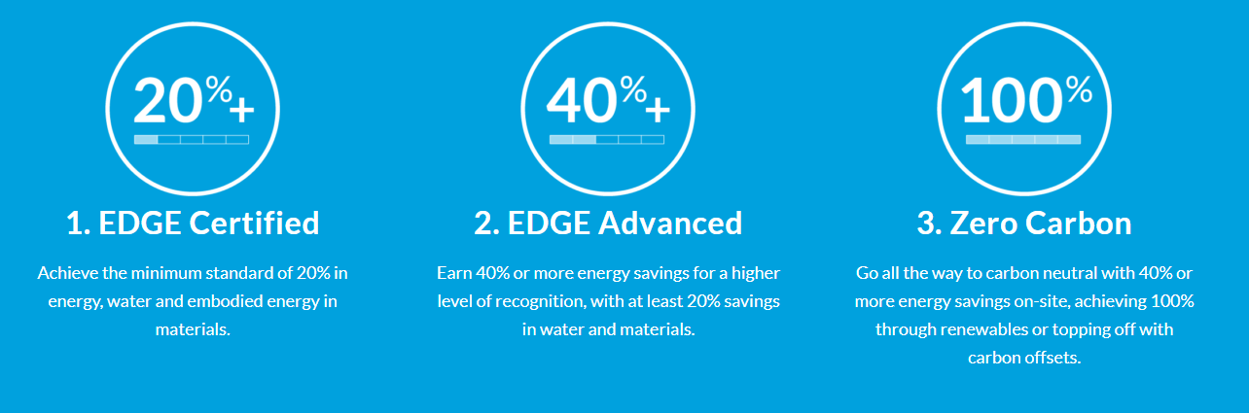
there are three ways to certify. Reach at least 20% savings in water and materials, then choose your energy savings. ________
Notes:
All EDGE-certified projects protect natural resources and save on operational expenses.
EDGE Advanced and Zero Carbon are opportunities for builders to aspire to even higher levels of certification.
EDGE supports the ambitions of Architecture 2030 and the World Green Building Council for new buildings to be zero carbon by 2030 and all buildings to be zero carbon by 2050.
The “Advancing Net Zero” initiative of the World Green Building Council aligns with the Paris Agreement to keep rising temperatures well below 2 degrees Celsius.

Slide 14
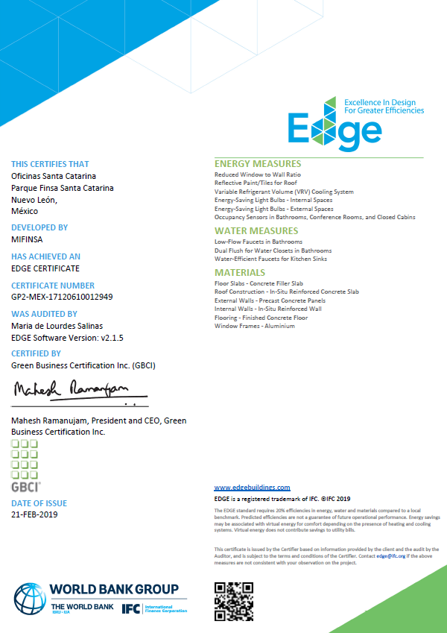
AN EDGE certificatE IS PROOF OF DELIVERY THAT YOUR PROJECT IS CERTIFIABLY GREEN
________
Notes:
If your project meets or exceeds the standard, it can be certified for a modest fee.
Each certificate lists the percentage savings and the measures utilized to achieve the green savings.
EDGE certification helps to communicate benefits among investors, developers, and your customers. The certificate verifies the claim and serves as a common language.
Investors don’t need to introduce new due diligence measures to recognize green building projects on their books.
When it comes to residential projects, EACH unit receives its own green certificate, which can then be used for green mortgages where they exist.

Slide 15
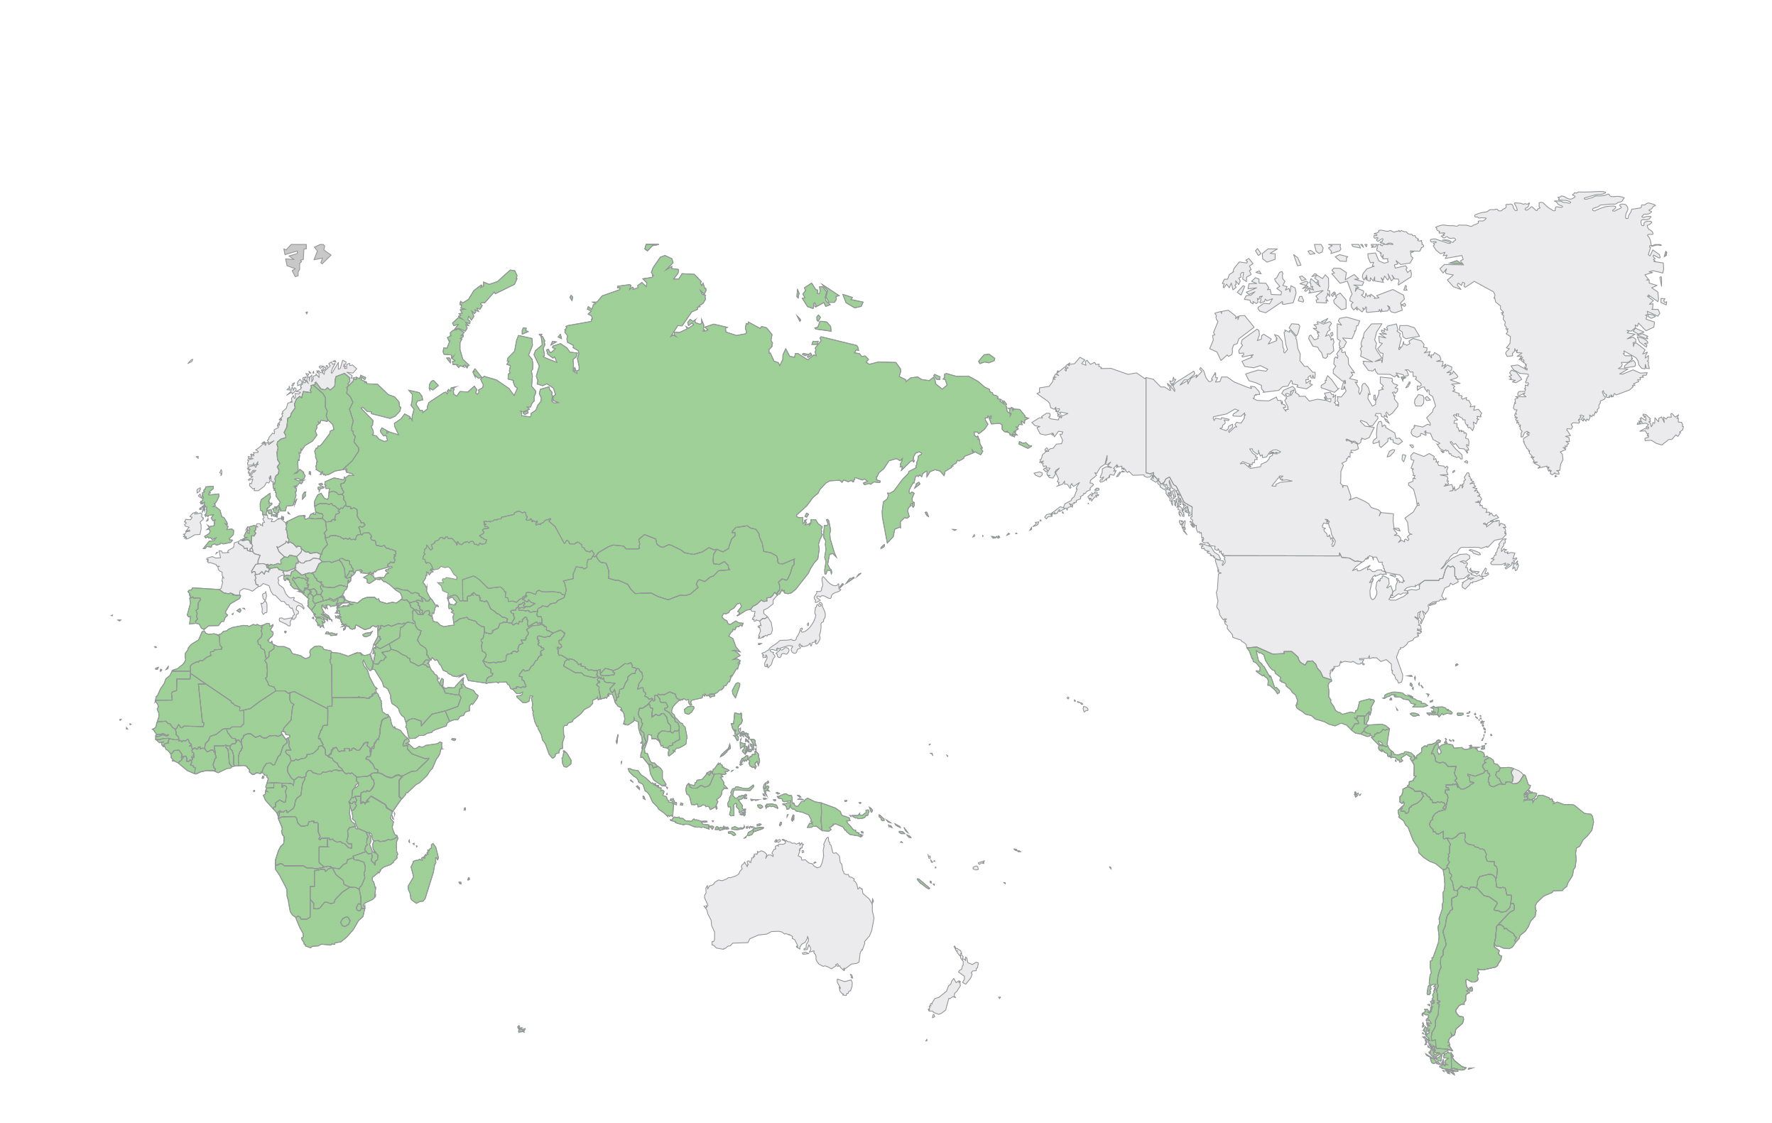
EDGE IS AVAILABLE IN more than 150 COUNTRIES, including Mexico
________
EDGE is focused on emerging markets because of the World Bank Group’s mission.
Notes:
EDGE is available for buildings designed in more than 150 countries, including Mexico.
There are country-specific certify pages on the EDGE website where you can find relevant information for your market.

Slide 16
HOW EDGE IS DIFFERENT THAN OTHER CERTIFICATION SYSTEMS ________
Financial calculator
Simplified compliance
Reduced processing
Easy impact reporting
Cost-effective
World bank group brand
Notes:
EDGE is different than other certification systems.
You’ll see first-hand how the EDGE software calculates the incremental cost and ROI for green measures – a unique feature among certification systems.
EDGE simplifies compliance by focusing on just three parameters: energy, water, and materials, with a one-stop shop for the entire design and certification process.
EDGE is much faster, more cost-effective, and more streamlined than other international standard certification systems.
EDGE makes green certification achievable for all, bringing international cachet to certified projects through association with the World Bank Group’s brand, delivering value to both you and your customers.

Slide 17
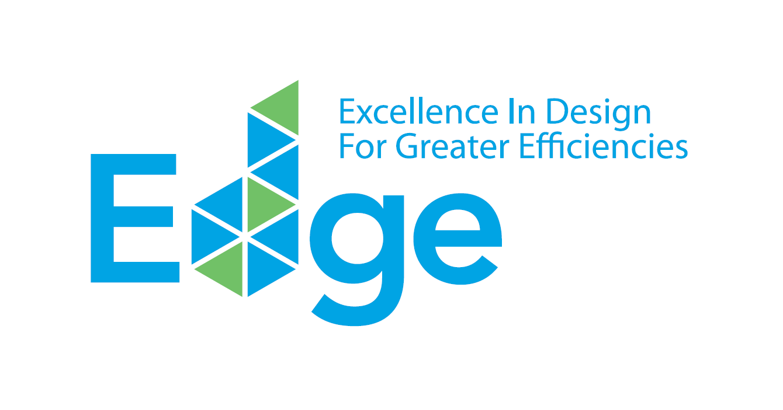
Edge demonstration ________
www.edgebuildings.com
Notes:
Let’s proceed to a live demonstration of the EDGE software and talk more about the certification process, in addition to sharing a few case studies.

Slide 18
certification WORKFLOW FOR PROPERTY DEVELOPERS
________
Use the EDGE App for self-assessment & project registration
Submit design documents into the EDGE App
Submit as-built documents into the EDGE App
Register
Design
Construction
Operation
Preliminary EDGE Certificate
Final EDGE CertificatION
EDGE co-marketing and project study for sales promotion
Preliminary Certificate serves as proof of compliance
Final proof of compliance
Impact reporting for the project
Model unit showcase opportunity
Notes:
Let’s look more closely at the EDGE certification workflow. EDGE projects receive both a preliminary EDGE certificate at the design stage, and final EDGE certification at the post-construction stage. A building currently under construction can skip the preliminary process and go straight to final certification.
As soon as the certificate is issued, a project study can be submitted for publishing on the EDGE website, with social media coverage provided across EDGE channels. The EDGE logo and brand guidelines are also provided for investor and/or sales promotion purposes.

Slide 19
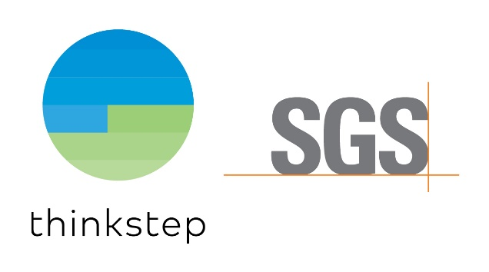
Global certifiers OFFER two different business models TO best meet YOUR needs
GBCI is the same entity that offers LEED certification.
Sliding scale fee, but capped for projects larger than 50,000 m²
Requires an independent auditor (appointed by GBCI or the client)
Fee for auditors independently negotiated
CERTIFICATION | PRICE PER M² | MINIMUM
0-25,000 FLOOR AREA (SQM) | $0.27 | $2,250
25,000-50,000 FLOOR AREA (SQM) | $0.22 | $6,750
> 50,000 FLOOR AREA (SQM) | — | $11,000 Flat Fee
The consortium of thinkstep and SGS sets the global benchmark for quality and integrity.
Flat fee for projects with one typology that includes both audit and certification
Discounts available for hiring an EDGE Expert or portfolio certifications
Pricing includes travel and incidentals
PROJECT TYPE | CERTIFICATION | DESIGN AUDIT | FINAL AUDIT | TOTAL
Residential (up to 3 unit types) | $2,400 | $4,000 | $4,000 | $10,400
Commercial (single end use) | $2,400 | $4,000 | 4,000 | $10,400
Further resource: EDGE Certify Country Pages
Notes:
In Mexico you have a choice between two certifiers with different business models.
GBCI, the operational entity of the U.S. Green Building Council that also offers LEED certification, has a sliding scale that requires an independent auditor with separately negotiated fees.
The consortium of thinkstep-SGS has a flat fee for projects with one typology, where both the audit and certification fee are included.

Slide 20
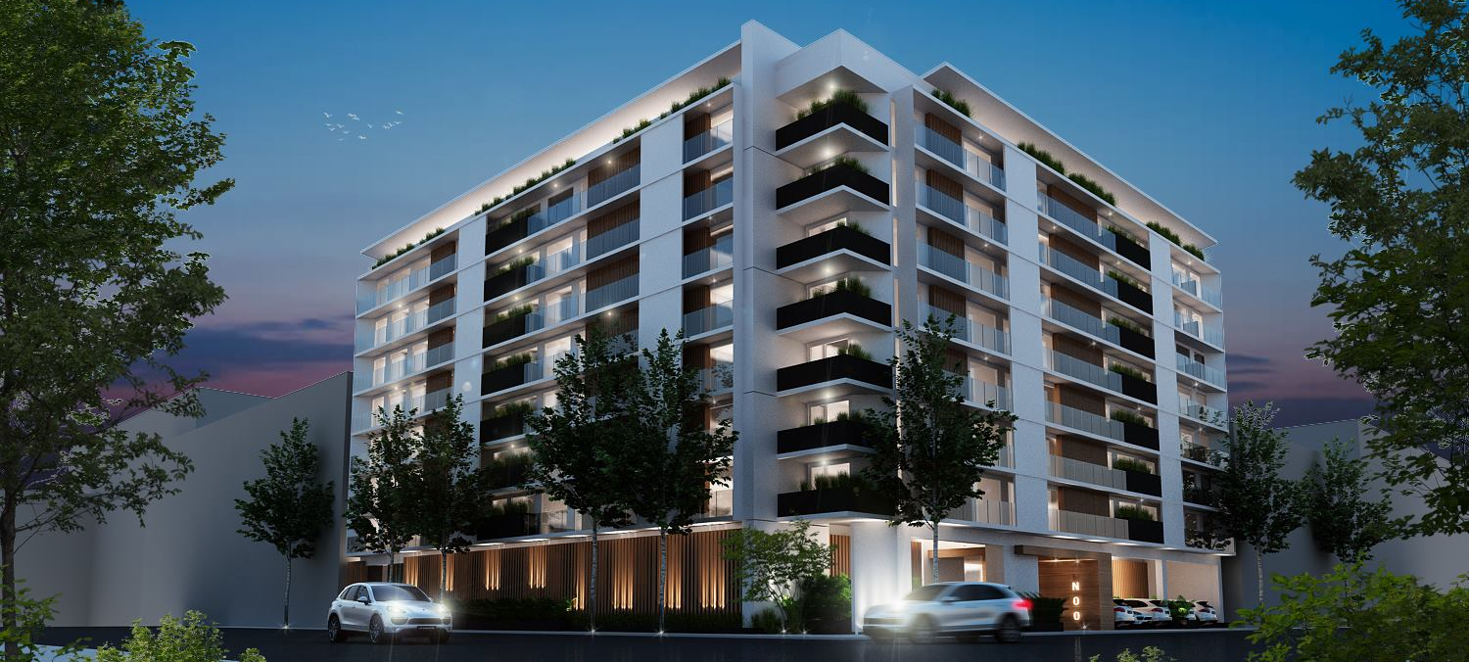
CASE STUDY: FICADE’s REVOLUCIÓN 757, LOCATED HERE IN MEXICO CITY, WILL OFFER 168 HOMES FOR ENVIRONMENTALLY-CONSCIOUS RESIDENTS
ACTUALS:
FICADE plans to certify all of its future properties with EDGE.
Resource-efficient features include external shading, high-efficiency boilers for hot water, and low-flow showerheads.
The apartments are made of honeycomb clay blocks.
Notes:
Let’s take a look at a few case studies to see how other property developers have started to adopt EDGE.
First, we have a case study from FICADE, whose Revolución 757, located here in Mexico City, has brought 168 EDGE-certified homes onto the market for environmentally-conscious residents.
Green features include external shading, high-efficiency boilers for hot water, and low-flow showerheads.
The apartments are made of honeycomb clay blocks to reduce the energy that went into the making of the construction materials.
The concept delivers on FICADE’s ambition to offer its customers properties that are green, with sophisticated urban design.

Slide 21
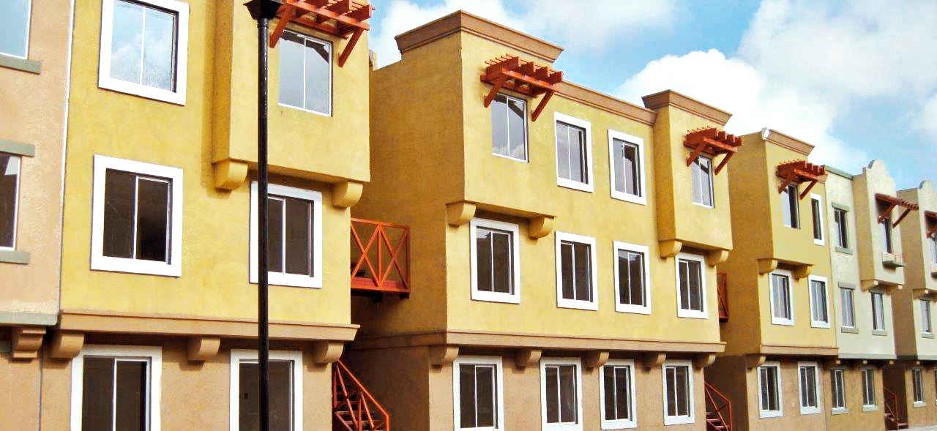
CASE STUDY: VINTE HAS COMMITTED TO CERTIFYING NEARLY 4,000 HOMES WITH EDGE, STARTING WITH REAL GRANADA
ACTUALS:
Green features include a reduced window to wall ratio, solar technologies, and rainwater harvesting systems.
The homes are made of medium-weight hollow concrete blocks.
Vinte’s goal is to improve their product and create great communities.
Notes:
Vinte has committed to certifying nearly 4,000 homes with EDGE. Vinte has issued a pair of green bonds that were secured in part because of their commitment to EDGE certification.
Green features include a reduced window to wall ratio, solar technologies, and rainwater harvesting systems.
The homes are made of medium-weight hollow concrete blocks that lower environmental impacts compared to traditional blocks.
According to Tobias Contreras, the Director of Sustainability at Vinte, “Our goal is to continue to improve our product and create great communities. Real Granada is a milestone for us and for the Mexican housing market in our transition towards more environmentally efficient housing.”

Slide 22
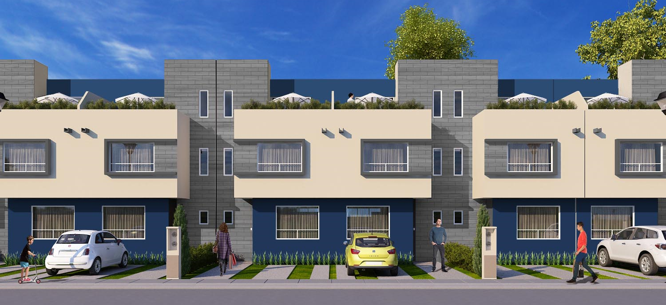
CASE STUDY: NEARLY 2,000 GREEN RESIDENCES WILL COME ONTO THE MARKET IN THE NORTHEAST REGION OF MEXICO WITH CASAS KREA’S VILLAS DEL FRESNO
ACTUALS:
Homes feature solar hot water collectors, energy-saving lighting, and low-flow faucets.
The payback period for incremental costs is less than two years.
Choosing EDGE is Casas Krea’s way to demonstrate its commitment to sustainable development.
Notes:
Casas Krea’s Villas del Fresno will build nearly 2,000 green residences in Melchor Ocampo that are certified with EDGE.
Green features include solar hot water collectors, energy-saving lighting, and low-flow faucets.
The payback period due to lower utility bills is less than two years. This is the value that Casas Krea passes on to its customers by building green.
In this way, Casas Krea demonstrates its commitment to sustainable development.

Slide 23
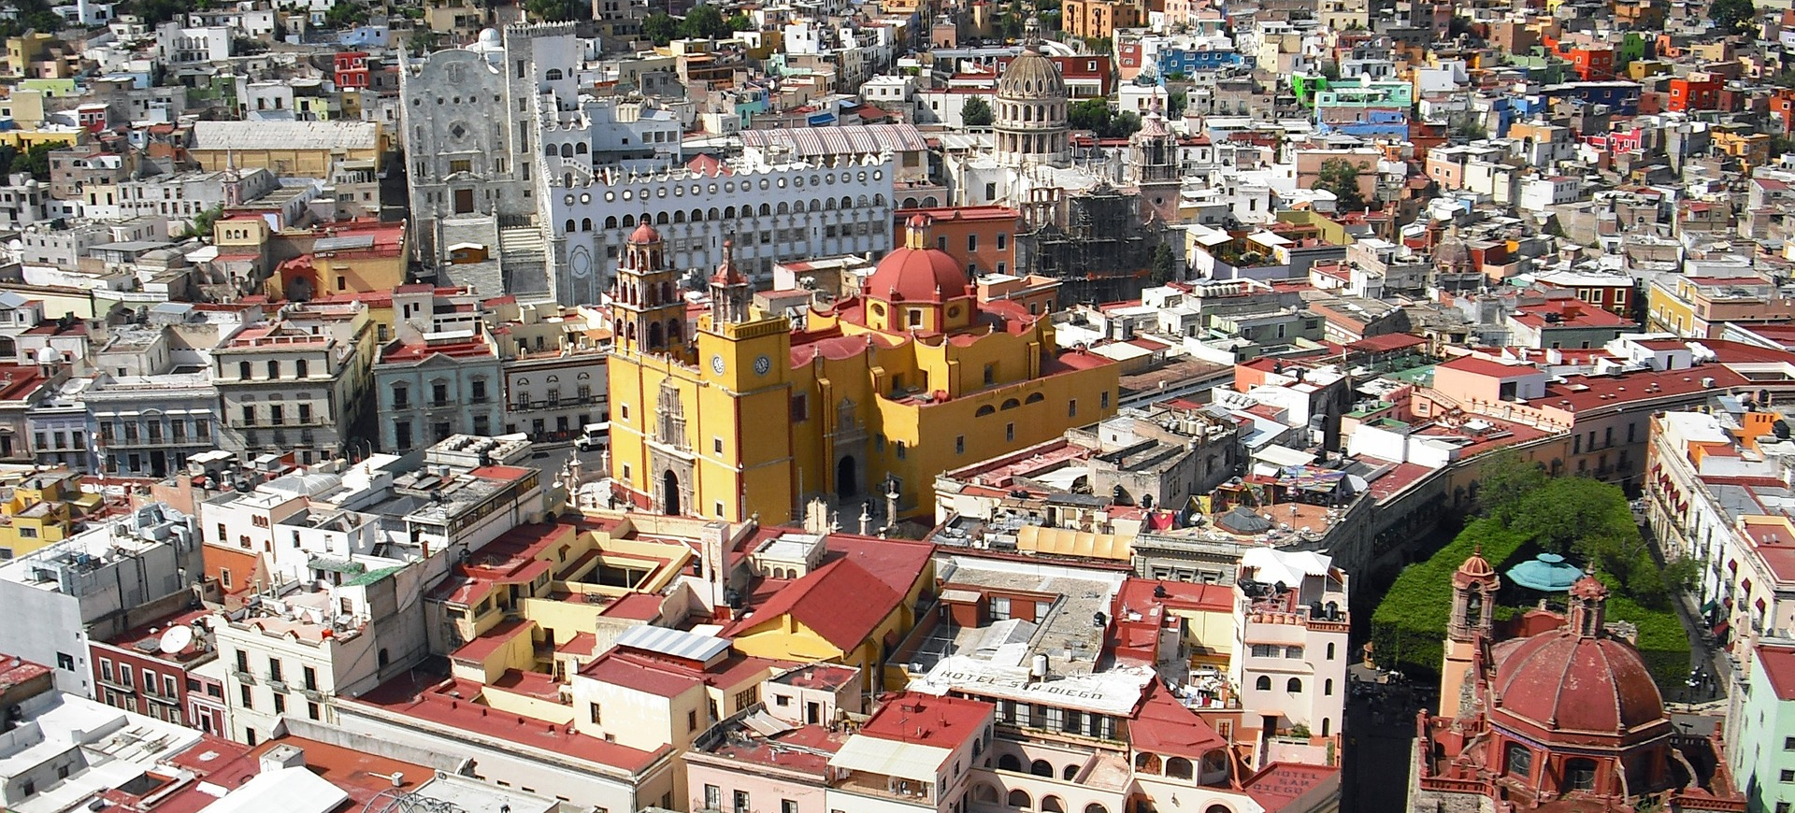
THE POTENTIAL TO WORK TOGETHER IN MEXICO CITY AND BEYOND.
Notes:
[CUSTOMIZE SUCH AS THE FOLLOWING]:
We know that [X] aims for profitable growth while creating value for your shareholders and clients. In addition to profit, transformation and internationalization are key pillars for [X]. We hope that EDGE will help support all the pillars for [X] and its clients and will become instrumental in supporting your investment relationship. To quote your philosophy on corporate social responsibility, we aim to “anticipate and care for the environment and society through the responsible performance of business activity in all regions in which we operate.”

Slide 24
EDGE acknowledgments ________
The following major donors have demonstrated their generous support of the EDGE program:
IFC also wishes to express its appreciation to the following donors:
The European Union; the Ministry of Finance of Japan; the Hungarian Export Import Bank; the Canada Climate Change Program and the Department of Foreign Affairs, Trade and Development Canada; the Royal Ministry of Foreign Affairs of Denmark and the Danish Green Growth Fund; the Federal Ministry of Finance of Austria; and the Ministry of Foreign Affairs of Finland. In addition, the support of the GEF-IFC Earth Fund Platform and the Energy Sector Management Assistance Program (ESMAP) of the World Bank helped seed EDGE.
Notes:
We also acknowledge IFC’s donor partners who have made EDGE and IFC’s work in green buildings possible. These governments and institutions are the reason IFC is able to offer the EDGE software application for free, as well as all of the awareness raising and promotional activities.

Slide 25
www.edgebuildings.com
Notes:
Thank you again for joining us today.
We appreciate your interest and hope you will decide to adopt EDGE certification for your future projects.

